Slide 1
Algal Bloom Awareness

Slide 2
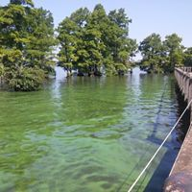
What is an Algal (algae) Bloom?
Algae are very tiny, often microscopic, plants or plantlike organisms that live in water or damp areas (Cyanobacteria)
(blue-green algae), which may actually look reddish-brown as well as bright green or blue-green. When conditions are right, large quantities of algae are produced to create a “Bloom”.

Slide 3
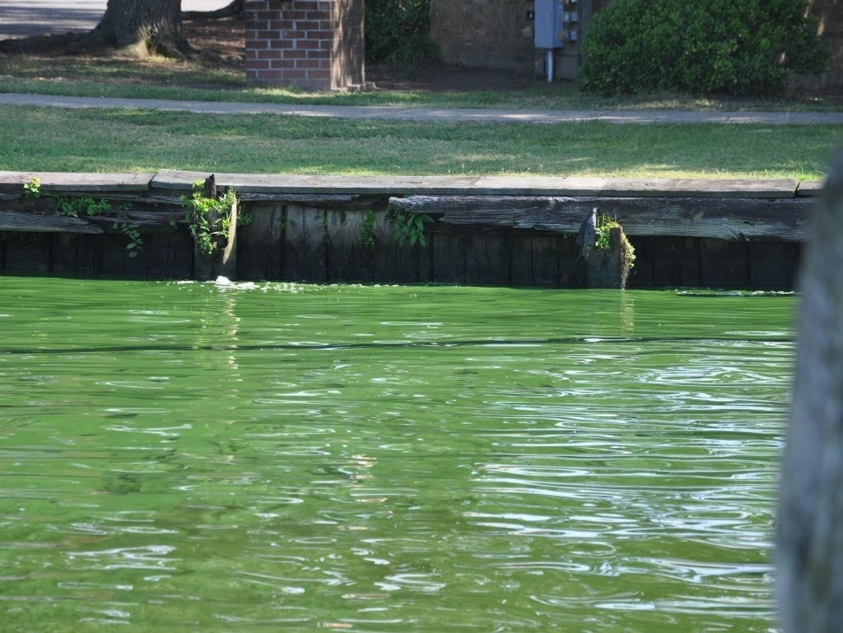
What Causes an Algal Bloom?
Sunlight
Hot Temperatures
Slow-moving water
Nutrients (nitrogen and phosphorus)
Nutrient pollution from human activities makes the problem worse, leading to more severe blooms that occur more often.

Slide 4
Awareness & Outreach Partners
Town of Edenton
Chowan County
Albemarle Commission
Albemarle RC&D
Chowan Edenton Environmental Group
JAH HS Bloom Busters
Albemarle Regional Health Department
NCDEQ
NC Sea Grant

Slide 5
Outreach Efforts
Working with Albemarle-Pamlico National Estuary Partnership to provide funding for notification signs at waterways, creeks, and inlets
If you see
Green Algae
Call: 877-623-6748

Slide 6
Outreach Efforts
NC Department of Environmental Quality Brochures
Stormwater Pollution: What’s Our Connection?
The Partners Added
If you see
Green Algae
Call: 877-623-6748

Slide 7
Outreach Efforts
Chowan Edenton Environmental Group is working with National Oceanic and Atmospheric Administration
Taking samples at 5 locations N to S along the Chowan River shoreline but not out in the river.
Sending Samples to NOAA SC Lab
Working with NOAA NC Lab to potentially develop use of satellite imagery to monitor blooms

Slide 8
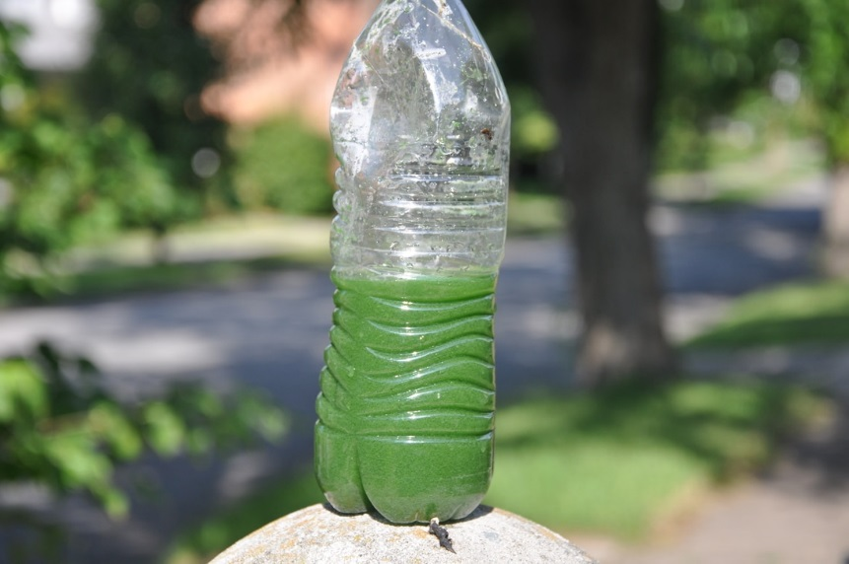
Outreach Efforts
John A. Holmes High School Bloom Busters
Created Local Algal Bloom Informational Brochure

Slide 9
Outreach Efforts
Albemarle Commission & Albemarle RC&D have applied for two planning grants – Clean Water Management Trust and DEQ Water Quality Grant to reach the land changes of the Chowan River Basin and what has changed to cause an increase in algal blooms
NC Sea Grant is planning a Algal Bloom Forum for local governments to educate them on algae and to create an outreach program

Slide 10
Outreach Efforts
Albemarle Resource Conservation & Development Council
Developed an Algal Bloom website
http://www.albemarlercd.org/algal-blooms.html

Slide 11
Response to Algal Bloom NCDHHS Recommends
Keep yourself, children and pets away from waters that appear discolored or scummy
If in doubt – stay out

Slide 12
Response to Algal Bloom NCDHHS Recommends
Do not handle or touch large accumulations ("scums" or mats) of algae
If in doubt – stay out

Slide 13
Response to Algal Bloom NCDHHS Recommends
Do not boat, water ski or jet ski over algal mats
If in doubt – stay out

Slide 14
Response to Algal Bloom NCDHHS Recommends
Do not use scummy water for cleaning or irrigation
If in doubt – stay out

Slide 15
Response to Algal Bloom NCDHHS Recommends
If you accidently come into contact with an algal bloom, wash thoroughly with HOT Soapy Water
If in doubt – stay out

Slide 16
Response to Algal Bloom NCDHHS Recommends
If you are unsure whether or not a bloom is present, it is best to stay out of the water
If in doubt – stay out

Slide 17
What Should I do if I see Algae?
CALL NC DEQ
877-623-6748
Report the Suspected Algae
If in doubt – stay out

Slide 18
QUESTIONS???
Thank you for Your Assistance in this Important Matter
Albemarle Commission: 512 S. Church St., Hertford, NC
Phone: 252-426-5753 www.albemarlecommission.org
Facebook: @AlbemarleCOG Twitter: @AlbemarleCOG

